Slide 1
Physiology (code)-year 2
Lecture 2(body fluid )
By Dr. Rafida Al- Amiri
Basic Science Department
college of dentistry
University of Basrah

Slide 2
Body Fluids
Body is formed by solids and fluids. The fluid part is more than 2/3 of the whole body.
Water forms most of the fluid part of the body. In human beings, the total body water (TBW) varies from 45 to 75% of body weight.

Slide 3
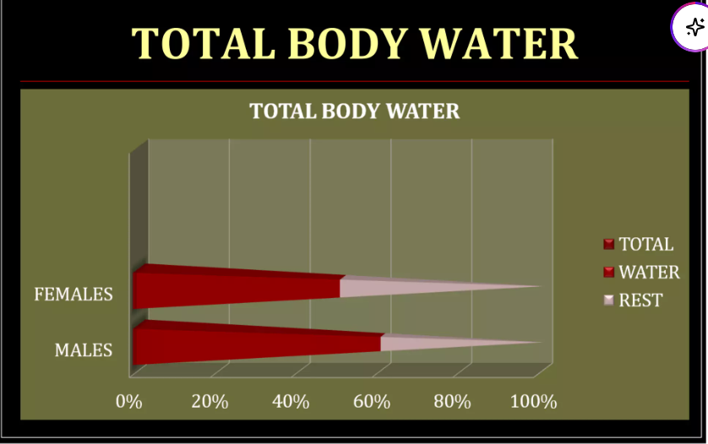

Slide 4
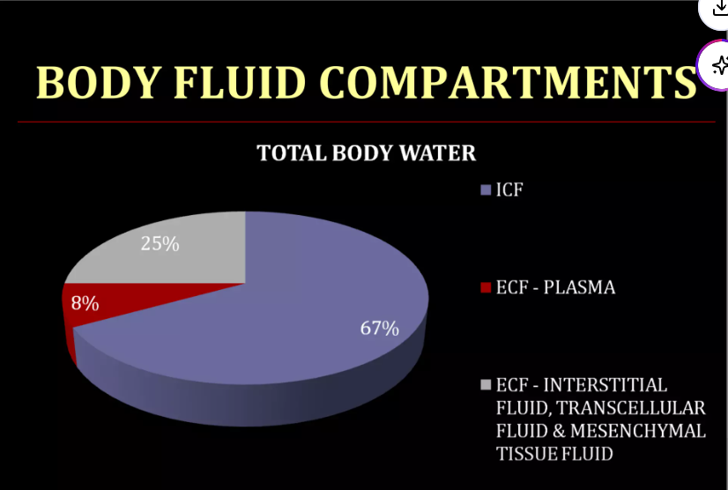
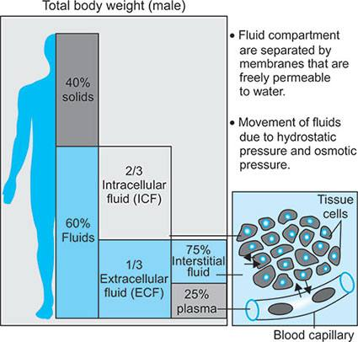

Slide 5
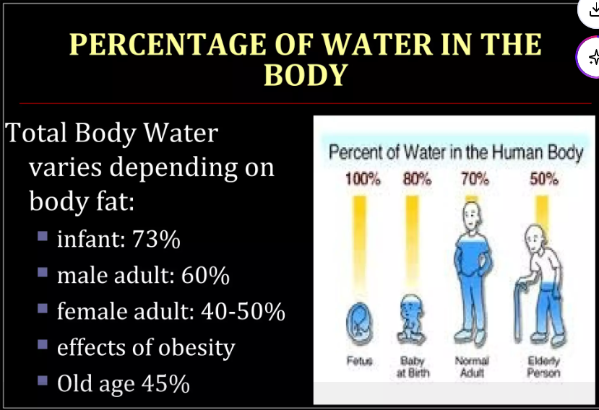

Slide 6
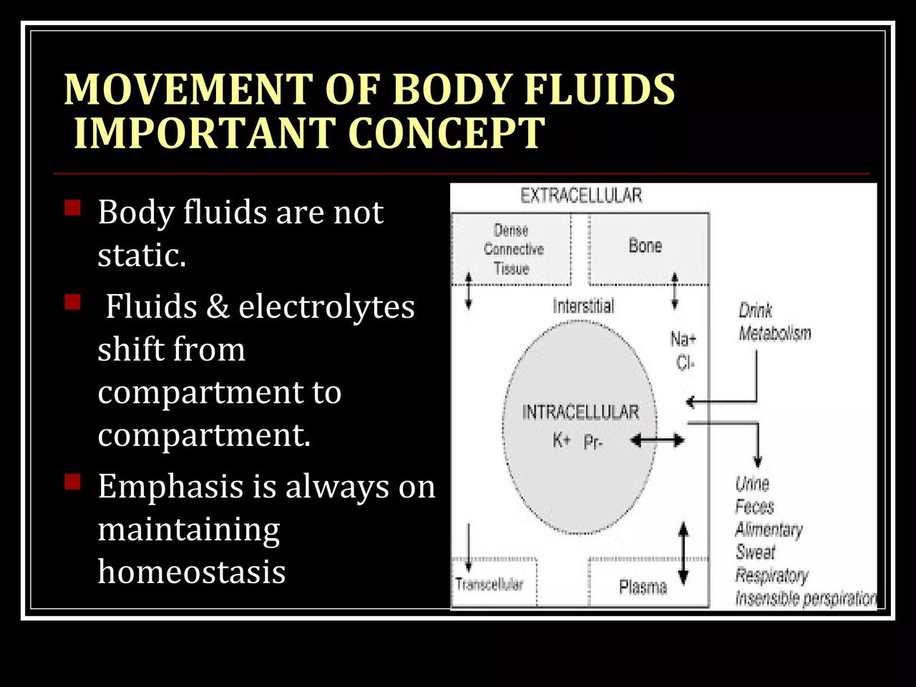

Slide 7
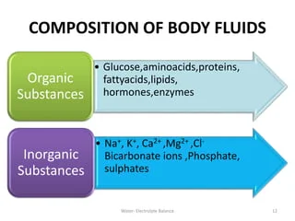

Slide 8
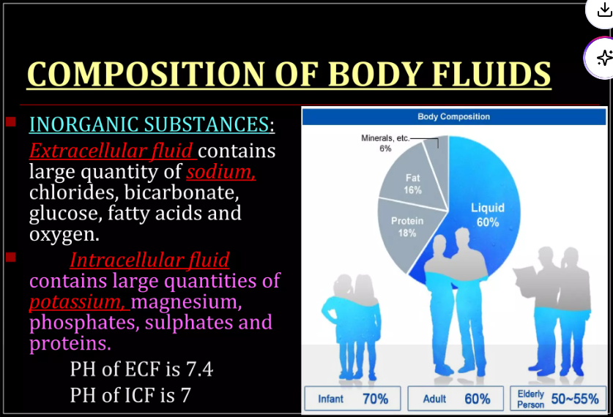

Slide 9
Q/ Why the extracellular fluid contains large quantity of sodium?

Slide 10
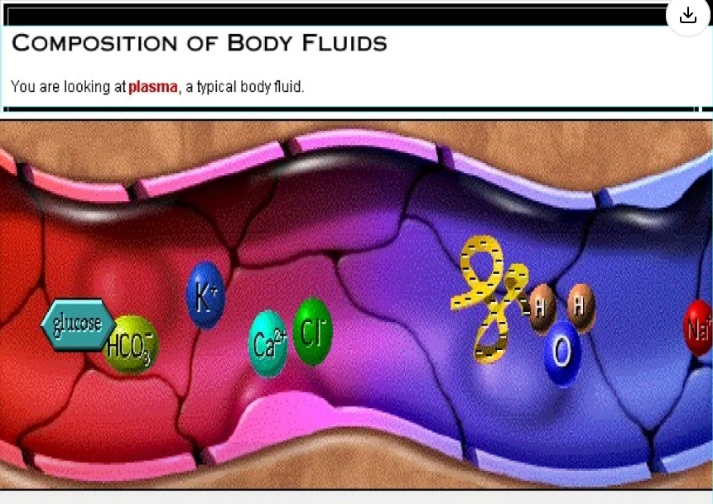

Slide 11
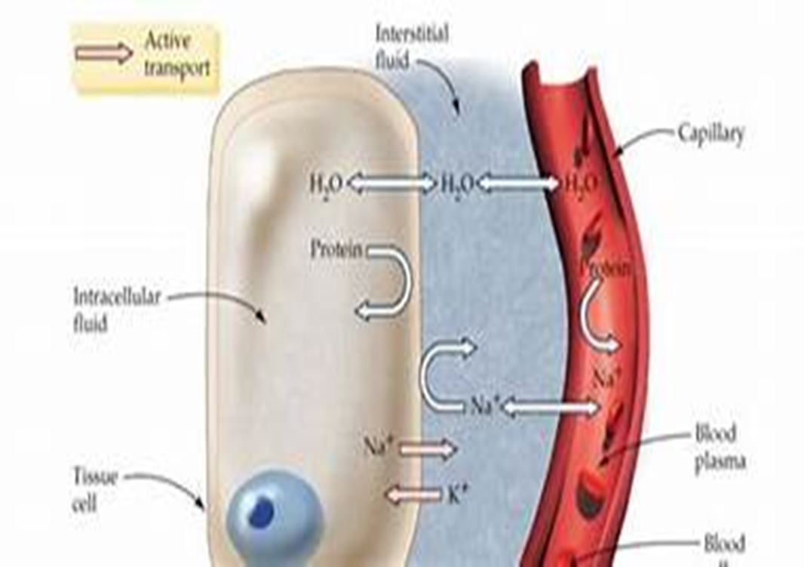
SIGNIFICANCE OF BODY FLUIDS IN HOMEOSTASIS:
Body cells survive in the fluid medium called internal environment or ‘milieu interieur’.
Internal environment contains substances such as glucose, amino acids, lipids, vitamins, ions, oxygen, etc. which are essential for growth and functioning of the cell.
Water not only forms the major constituent of internal environment but also plays an important role in homeostasis.

Slide 12
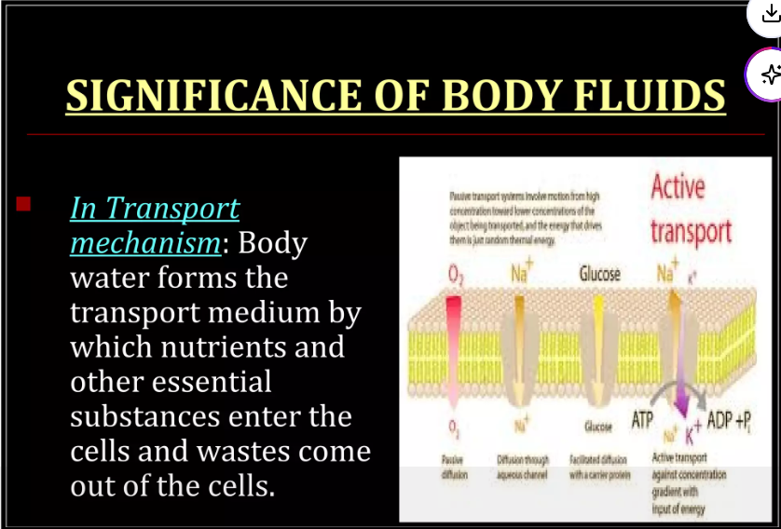
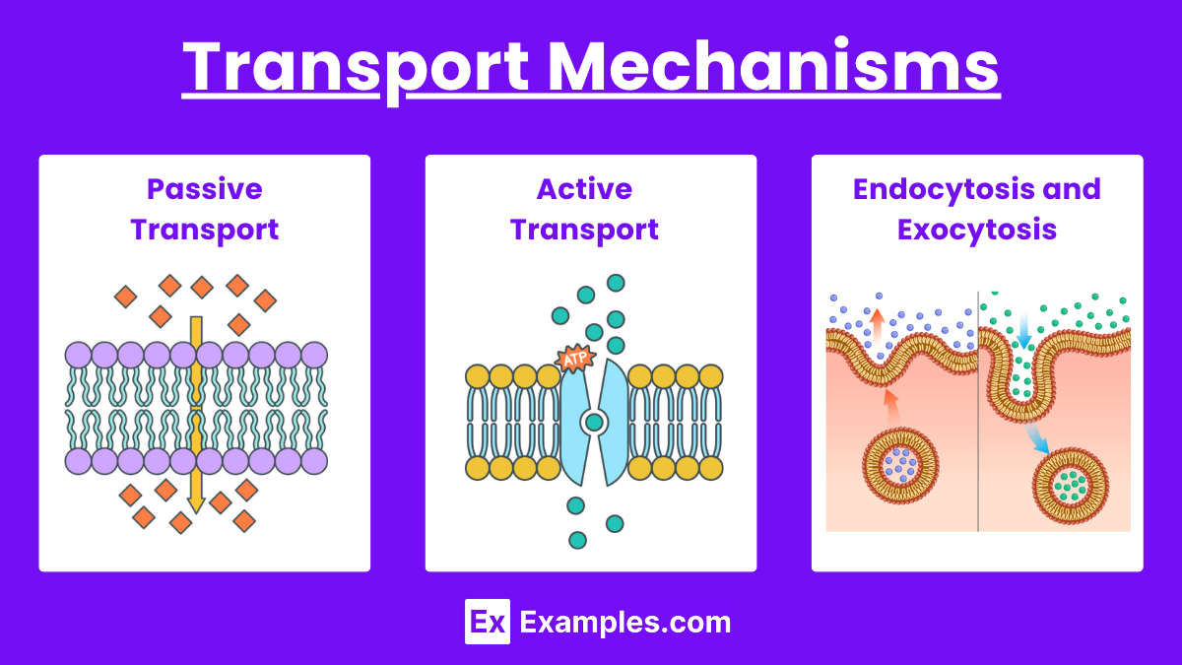

Slide 13
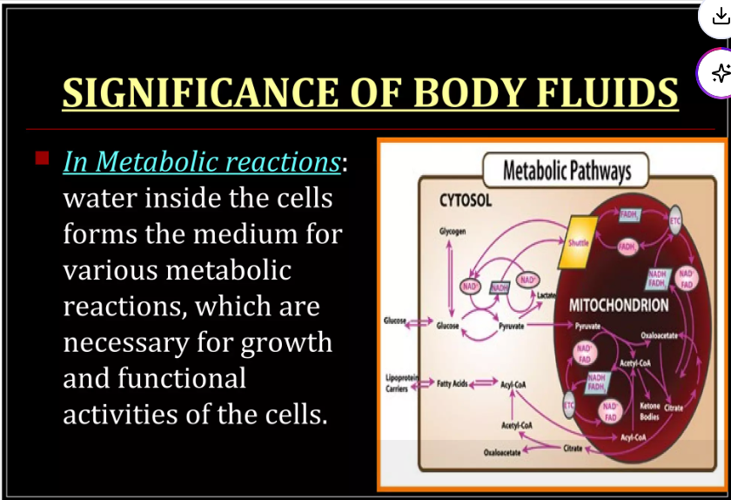

Slide 14
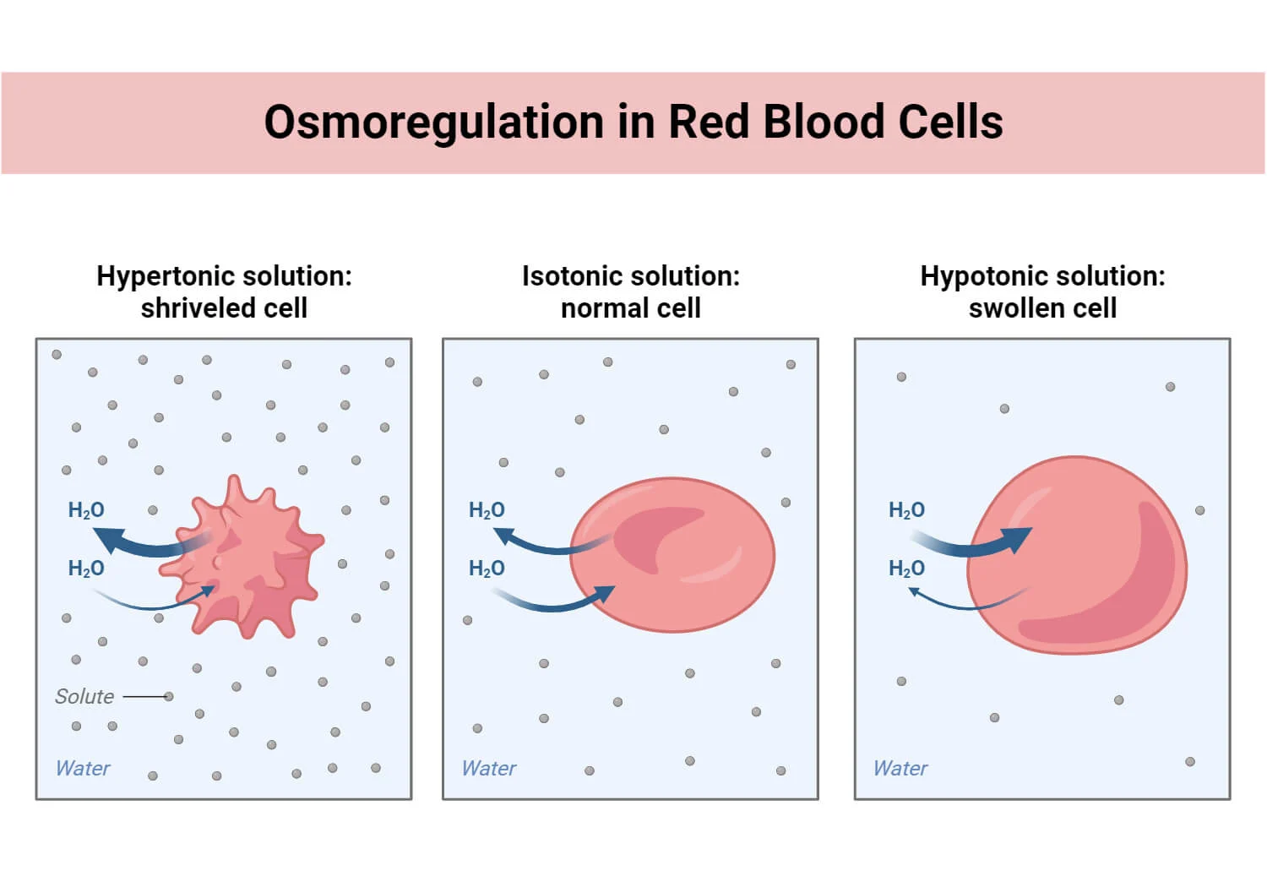
IN TEXTURE OF TISSUES:
Water inside the cells is necessary for characteristic form and texture of various tissues.
IN TEMPERATURE REGULATION
Water plays a vital role in the maintenance of normal body temperature.

Slide 15
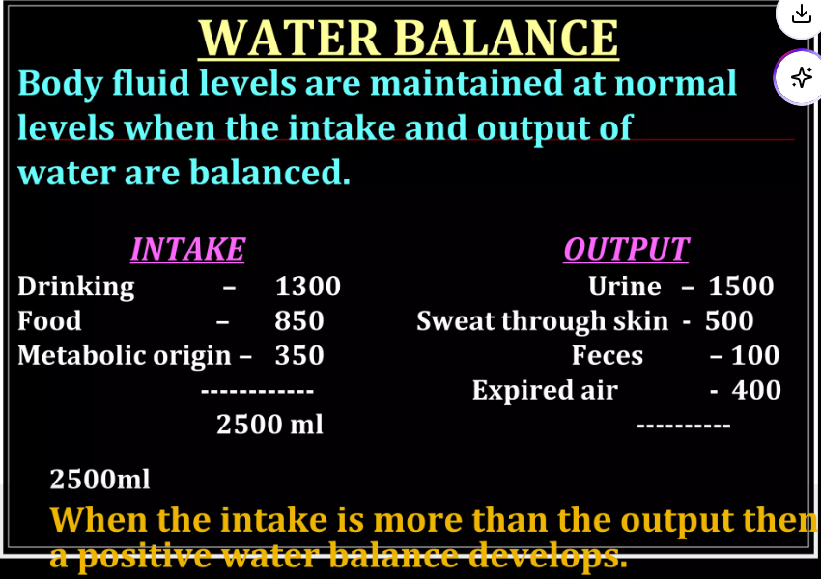

Slide 16
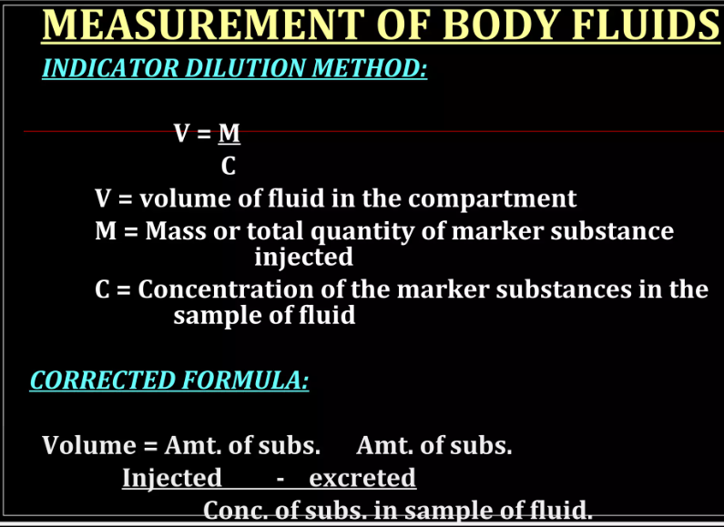

Slide 17
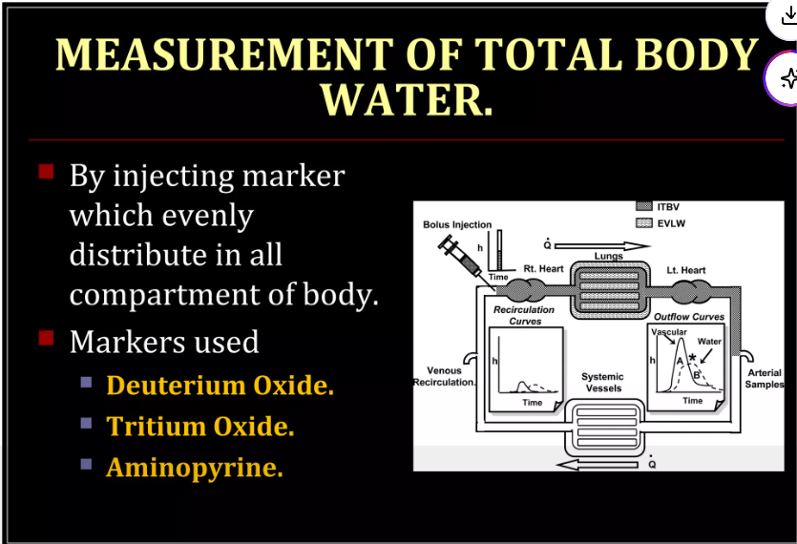
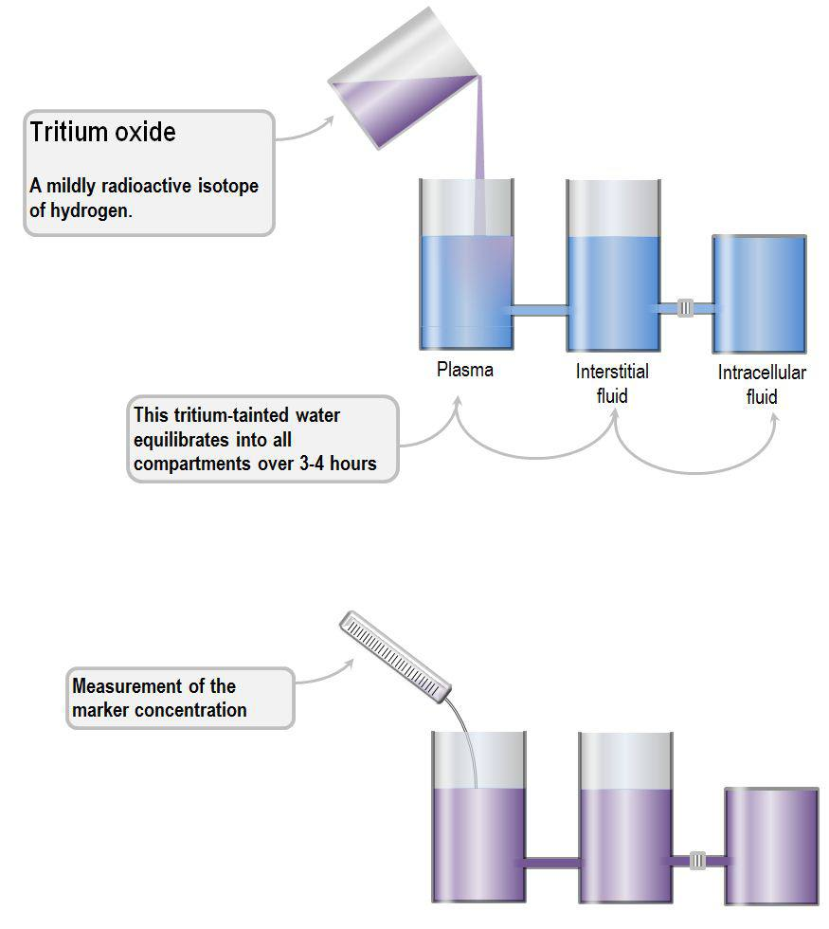

Slide 18
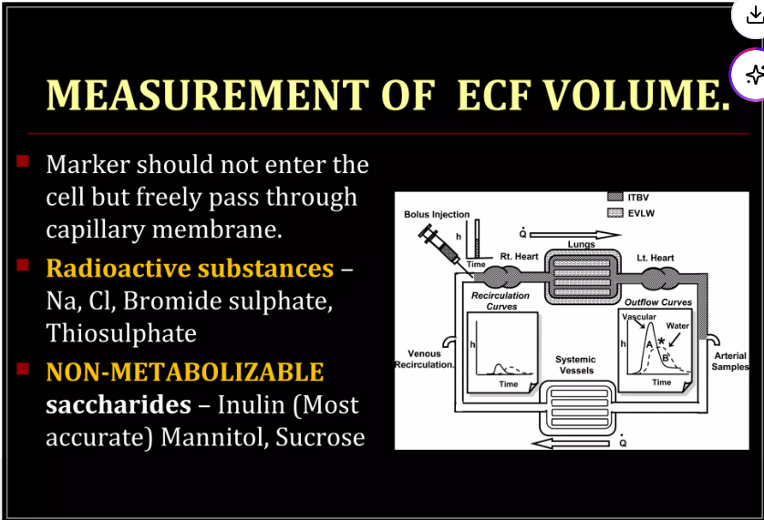
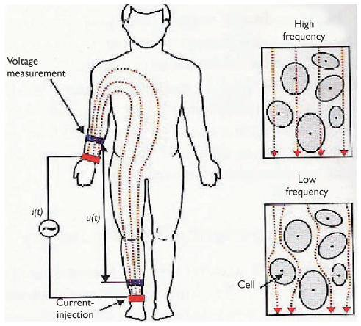

Slide 19
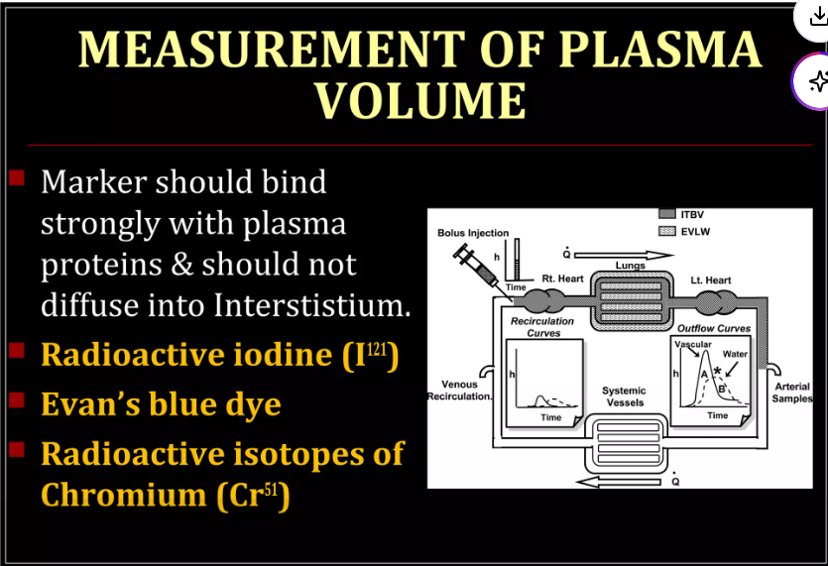
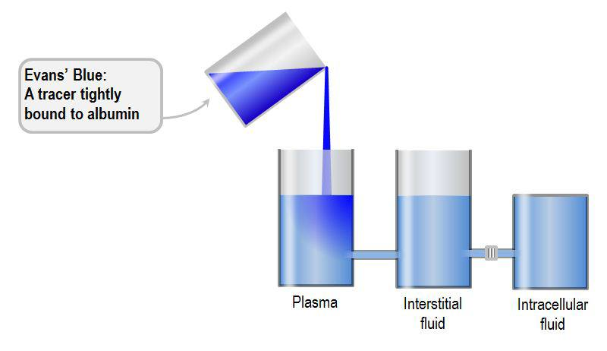

Slide 20
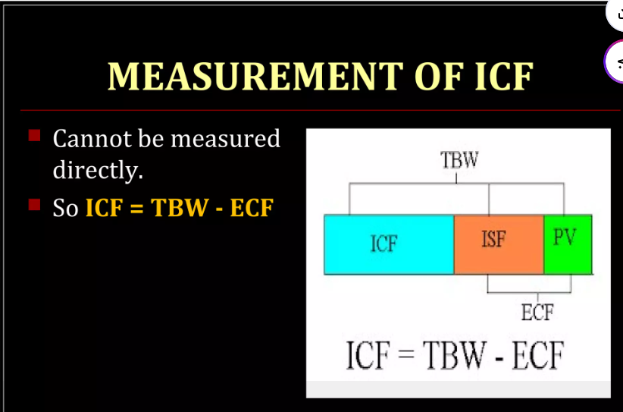

Slide 21
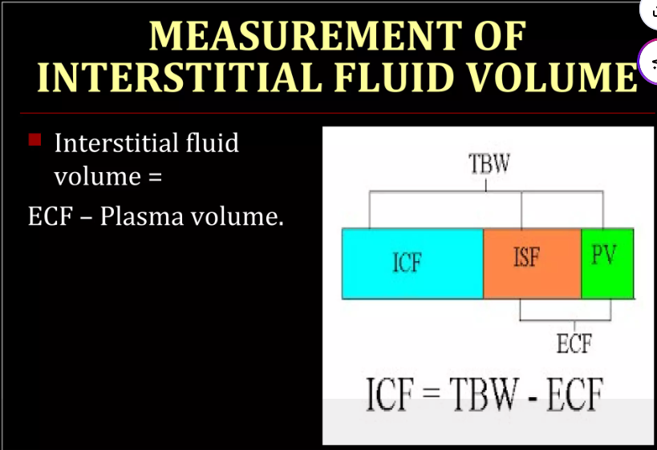

Slide 22
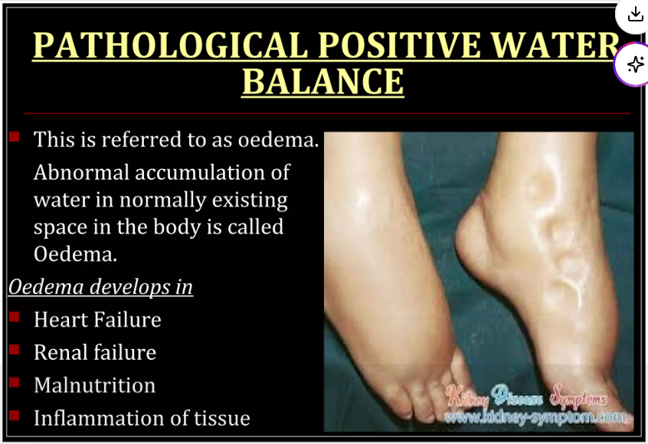

Slide 23
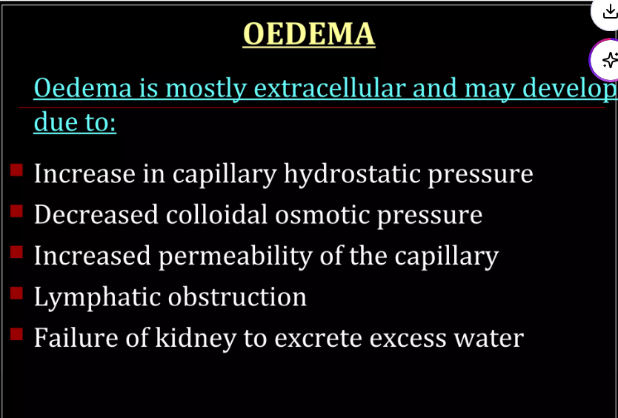

Slide 24
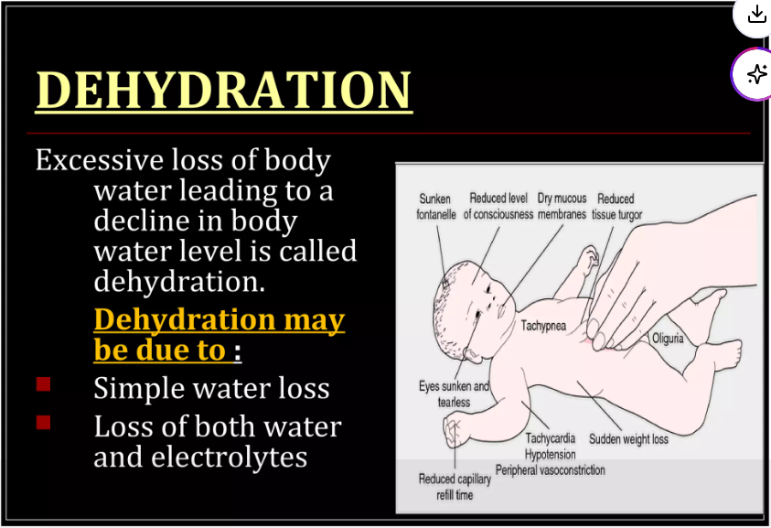

Slide 25


Slide 26


